Slide 1
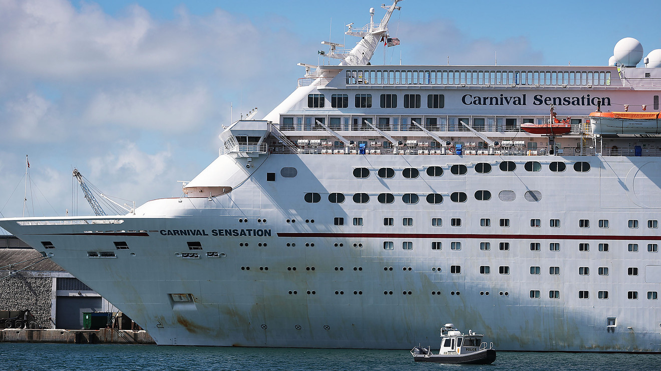
Compliance with the Law
https://www.marketwatch.com/story/carnival-cruises-ordered-to-pay-20-million-for-dumping-plastic-and-food-waste-into-the-ocean-lawyer-says-it-tried-to-drown-its-deceit-2019-06-05

Slide 2
Carnival Corp. and its subsidiary Princess Cruise Lines has been ordered to pay $20 million for environmental violations just two years after it paid $40 million for dumping oil-contaminated waste into the ocean, the largest penalty of its kind at the time.
Full details:
https://www.justice.gov/opa/pr/princess-cruise-lines-and-its-parent-company-plead-guilty-environmental-probation-violations

Slide 3
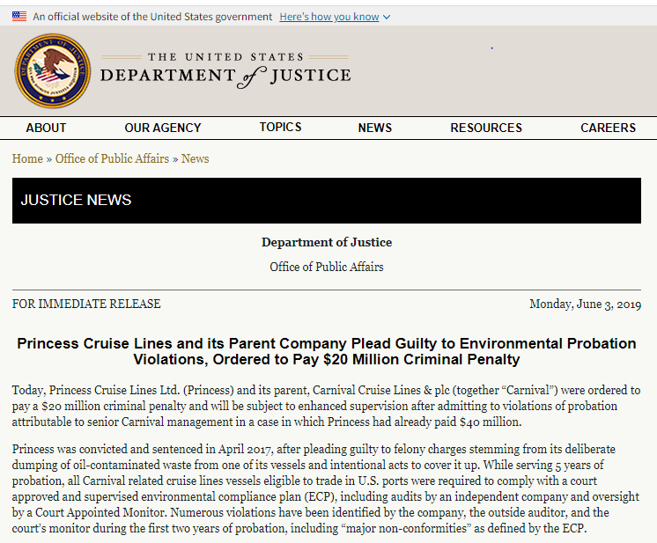
Full details:

Slide 4
Violations included:
Failing to establish a senior corporate officer as a corporate compliance manager with responsibility and sufficient authority for implementing new environmental measures required during probation.
Contacting the Coast Guard seeking to re-define the definition of what constitutes a major non-conformity under the ECP without going through the required process.
Were told the company to file a motion with the court if it wanted to pursue the issue of none comnplianmce.
Deliberately falsified environmental training records aboard two cruise ships.
Deliberately discharged plastic in Bahamian waters from the Carnival Elation.
Failed to accurately record the illegal discharges and record them.
failed to segregate plastic and non-food garbage.

Slide 5
Under terms of the settlement, Carnival will do the following:
Pay a $20 million criminal penalty.
Issue a statement to all employees saying CEO responsible for the probation violations.
Appoint a Corporate Compliance Officer, add a new member to the Board of Directors with corporate compliance expertise.
Train Board of Directors
Pay up to $10 million per day if it does not meet deadlines for submitting and implementing needed changes to its corporate structure.
Pay for 15 additional independent audits per year conducted by the third-party auditor and Court Appointed Officer.
Comply with new violation reporting requirements.
Make major changes to disposal of plastic waste materials.

Slide 6
DISCUSSION: Does a fine go far enough?...
Carnival reported $18.8 billion in revenue in 2018, according to its most recent annual report.
Shares of Carnival are up 6% year-to-date.
Should CEO and senior management be jailed?
Damage awards ?
Revenue affected by COVID ?

